Slide 1


September 16, 2025
9:00 AM – 11:00 AM
MVCC: Rome campus PC 150CA

Slide 2
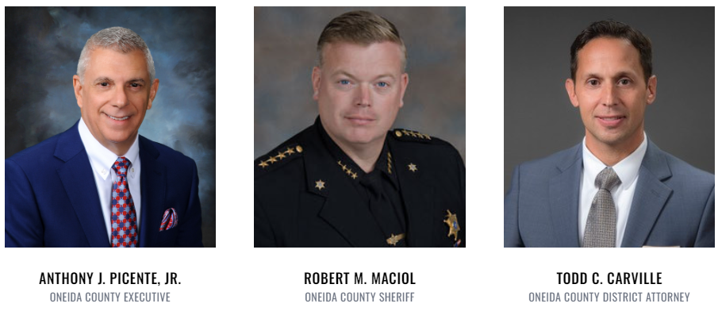
Welcome & Introductions
Co-Chairs

Slide 3




ONEIDA COUNTY OPIOID TASK FORCE
OVERDOSE RESPONSE TEAM
DATA ANALYSIS SUBTEAM
CY 2024 OVERDOSE DATA
SFC CORY WHITE
(16 SEP 2025)
MVCAC / NYNGCDTF

Slide 4

NALOXONE ADMINISTERED BY BYSTANDER
52
35
46%
26%
29%
23%
45
SINGLE
78
NONE
TOTAL
178
55
MULTIPLE
19%
SINGLE
NONE
TOTAL
MULTIPLE
16%
52
70%
328
154
122
NALOXONE USED

Slide 5
- 14% Decrease from CY24
- 60% Decrease from CY24
- 32 of 49 (63%) Overdoses involved naloxone administration
- 59% Decrease from CY24
- 38% Decrease from CY24
- 51% Decrease from CY23
- 25% Decrease from CY23
- 48 of 71 (67%) overdoses involved naloxone administration
- 83% Decrease from CY24
- 17% Decrease from CY24
- 34% Decrease from CY23
- 30% Decrease from CY23
- 61% increase from CY23
- 21% Decrease from CY23
- 19% Decrease from CY23

Slide 6
- 3 cases contained Lidocaine, 2 cases contained Xylazine, 1 case contained Bromazolam/Lidocaine, 1 case contained all 3 substances, and 1 case contained Lidocaine/Xylazine
- 1 case contained Lidocaine, 1 case contained Xylazine, 1 case contained Xylazine/Lidocaine
8
1
2
- BROMAZOLAM
- XYLAZINE
- LIDOCAINE

Slide 8
Utica: 63% of OD’s in Oneida County.
Rome: 16% of OD’s in Oneida County.
Utica: 55% of OD’s in Oneida County.
Rome: 9% of OD’s in Oneida County.
New Hartford: 8% of OD’s in Oneida County.
New Hartford: 8% of OD’s in Oneida County.

Slide 9
As of 9/15/2024, January and February have the most recorded overdoses with totals of 26.
As of 9/15/2024, Wednesday has the most recorded overdoses with a total of 34.
As of 12/31/2024, February has the most recorded overdoses with a total of 33.
As of 12/31/2024, Monday has the most recorded overdoses with a total of 57.

Slide 10
Meeting 1: Conducted a review of objectives and established a priority ranking
Meeting 2: Examined the highest priority objectives and generated a list of proposed initiatives
Meeting 3: Researched and evaluated the proposed initiatives for feasibility and impact

Slide 11
Workgroup Initiatives
Education and Prevention Team
Treatment Enhancement Team
Government and Policy Liaison (Data and Quality Improvement) Team
Overdose Response and Harm Reduction Team
Recovery Team
Lived Experience

Slide 12
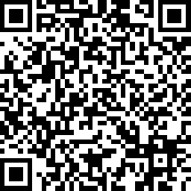
Education and Prevention Team:
Proposed Ideas:
Expand
Expand Narcan access in all schools
- Revisit the initiative encouraging school boards to adopt a policy ensuring the availability of Narcan in schools
Promote
Promote Narcan through PSA
Evaluate
Evaluate all schools drug/alcohol intervention programs
- Encourage more school programming and educational presentations

Slide 13
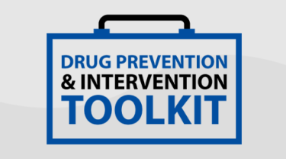
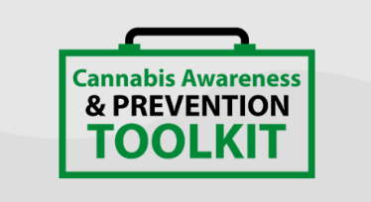
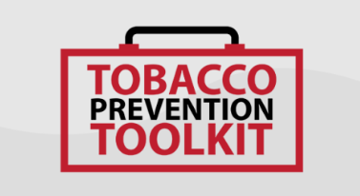
Education and Prevention Team:
Recommendation of an Educational Intervention Strategy
Stanford Medicine: Halpern-Fischer REACH Lab: the lab has developed several prevention and intervention Toolkits and curriculums aimed at preventing and reducing adolescent and young adult substance use
Evidence-informed
Evidence-based
Free curriculum training
Teach students information about different drugs
Raise awareness of deceptive marketing strategies targeting youth
Build skills to resist experimenting with or using drugs
Explain adolescent brain development and effects of addiction
Support positive youth development and overall health

Slide 14
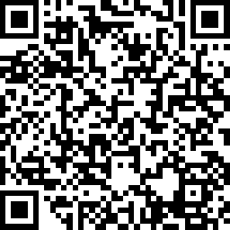
Treatment Enhancement Team:
Oneida County has limited transitional housing
Transitional Housing Models: short-term housing with professional supports to address multiple needs (housing, employment, mental health, and substance use)
Three different housing models:
Scattered Site
Individuals live in apartments spread throughout the community
Supportive services are provided by mobile staff who visit or meet at community sites
Promotes independence and integration
Reduces stigma compared to “group housing”
Evidence shows that this model improves long term housing stability and community reintegration
Clustered Site
Multiple transitional housing units grouped in the same building or neighborhood
Residents live separately but have shared access to on site staff, recovery groups, and common spaces
Easy for staff to provide consistent services and monitor recovery
Shown to have better treatment engagement and higher program retention
Communal Living
Individuals live together in a single home (similar to Oxford Houses)
Builds recovery capital (social networks, friendships, sober routines)
Higher abstinence rates and reduced relapse

Slide 15




Treatment Enhancement Team:
Barrier Type | Scattered Site | Clusterd Site | Communal Living
Funding & Sustainability | Reliant on private landlords | High upfront development & ongoing maintenance costs | Lower per-unit cost but high staffing/operations costs
Policy & Regulatory | Landlord reluctance due to vouchers/backgrounds | Zoning restrictions | Licensing requirements stricter
Community / Social (NIMBYism, Stigma) | Neighbors resistant to tenants with histories of SUD or incarceration | Visible “project” identity can generate neighborhood opposition and stigma. | Viewed as “shelter- like” reinforcing stigma
Programmatic & Operational | Hard to monitor residents consistently across scattered locations | Easier to deliver on-site services but higher overhead | Tensions from shared spaces and strict house rules
Resident-Level Challenges | Isolation from peers and limited peer support | Peer support possible but risk of residents clustering without integration into broader community. | Conflicts among residents due to close quarters
Barriers to Implementing Transitional Housing Models

Slide 16

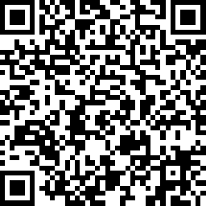
Recovery Team:
Gap in supportive long-term housing
Shift from transitional to sober living by reorienting the housing model around recovery goals
Sober Living Models: primarily about maintaining sobriety through peer accountability in a drug-free environment
Substance Free and Stable Environment
Peer Support and Community
Owned Privately or by Treatment Facilities
Accountability and Guidance
Focus on Recovery Skills
Independent Living
Shared Expenses
Stay as long as you like, provided that you stay clean, pay rent, and are non-disruptive

Slide 17
Recovery Team:
Recovery Residences (OASAS)
Community-Based Shared Living Environments for individuals maintaining and sustaining recovery from substance use disorder
Opioid Settlement funds of $5M are available. A funding opportunity for newly certified recovery residence providers to enhance their current residence sites
Providers with more than one Recovery Residence may apply for this one-time award for up to three (3) individual sites, and each site may receive up to $75,000 in funding each (up to a maximum possible total of $225,000)
Funding available for recovery residences (Sober living housing)

Slide 18
Recovery Team
There is a growing need for additional
Certified Recovery Peer Advocates (CRPA)
What is a Certified Peer Recovery Advocate?
Certified Recovery Peer Advocates (CRPAs) use their lived experience to provide non-clinical support to individuals in treatment
and recovery.
What does a CRPA do?
CRPAs help with treatment and recovery
by assisting with outreach, education,
linking clients to formal recovery supports,
and benefits.
Where do CRPAs work?
CRPAs are employed by treatment and recovery agencies to assist and provide support from a lived-experience perspective.
How do you become CRPA?
The New York Certification Board requires 46-hours of approved training and 4 hours of Medication Supported Recovery Training.
Are you qualified to be a CRPA?
18+ years
Have lived-experience with substance use
High School Diploma (or equivalent or higher)

Slide 19
Recovery Team:
Recommendations
Workforce Development and Training
Recruitment and Outreach
Career Pathways and Sustainability
Monitoring and Evaluation
Expand training access
Targeted recruitment
Integrate into agencies
Track outcomes
Certified Recovery Peer Advocates

Slide 20
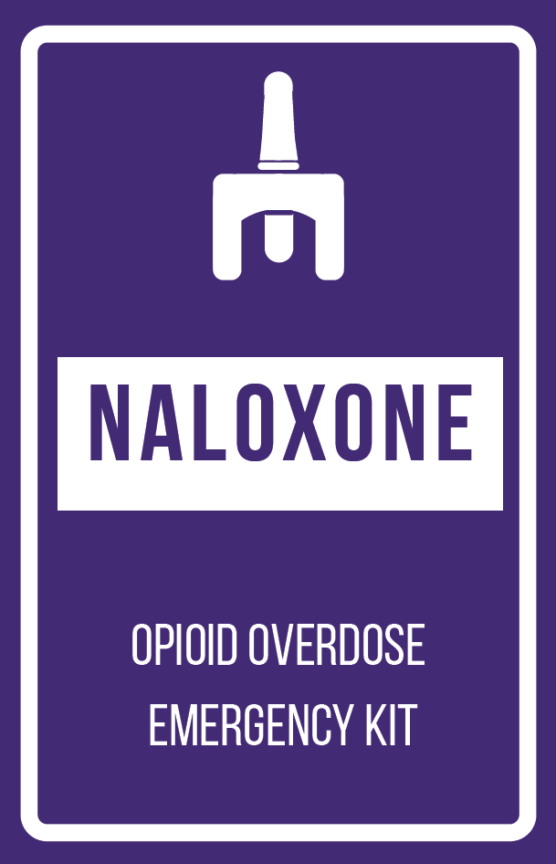
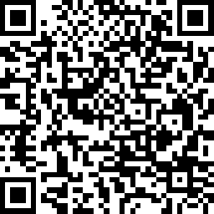
Overdose Response and Harm Reduction Team:
Active Initiatives
Data Analysis Subgroup
  Create a more comprehensive data collection approach
Promote Narcan distribution through signage
  Signage is being placed on AED cabinets in public spaces to increase awareness and access

Slide 21
Overdose Response and Harm Reduction Team:
Recommendations
Explore a centralized reporting system for Narcan distribution and usage
Agencies can submit monthly data on Narcan distribution and usage
Develop a template for reporting
Explore ways to track overdoses not reported through law enforcement

Slide 22
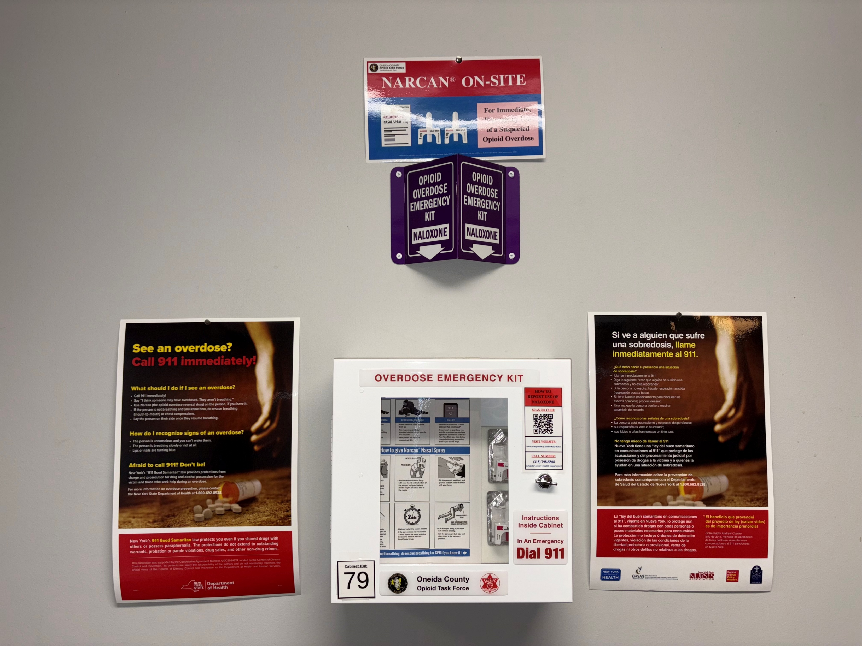
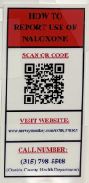
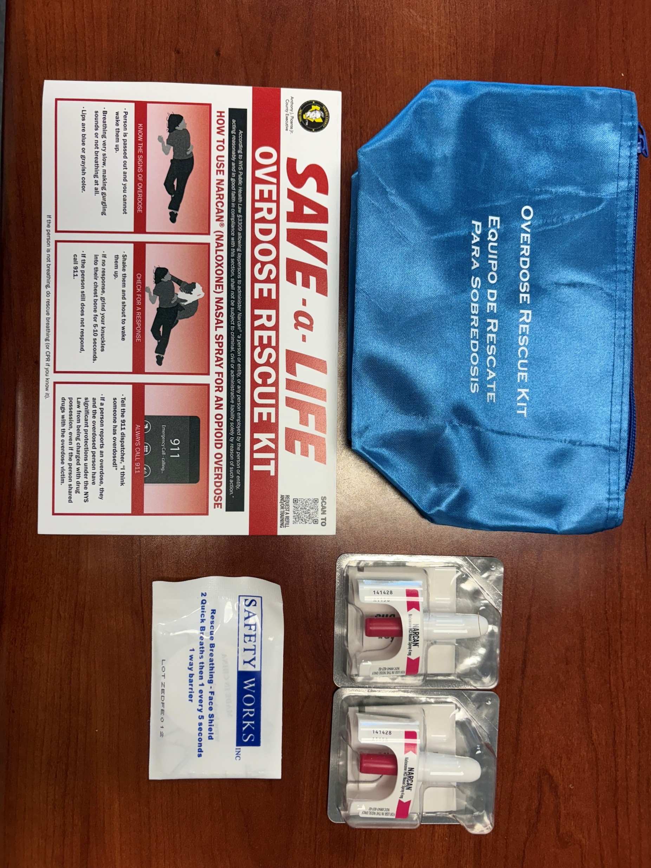
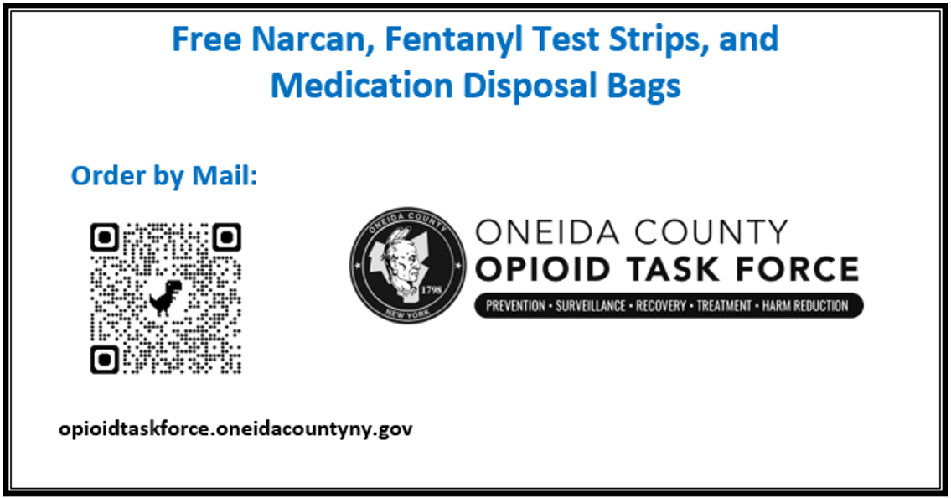
Overdose Response and Harm Reduction Team:
Each Narcan Cabinet is Labeled
Cabinets have their own
QR codes to report usage
Cards are given out to people at tabling events

Slide 23
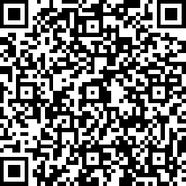
Government Policy & Liaison Team
(Data Quality Improvement):
Legislative Change Discussion
Court and Treatment Challenges
Information Sharing
Restoration and Competency
Educate about treatment alternatives to incarceration
Develop more comprehensive information-sharing protocols
Narcan and Staff Training
Implement mandatory Narcan training for client-facing staff
Create more supportive pathways for individuals with substance use disorders

Slide 24

Lived Experience Workgroup:
Confirmed that the initiatives and proposed ideas are impactful steps towards recovery and sobriety
One individual shared her journey from experiencing an overdose to her current stage of recovery, noting that Oneida County now offers significantly more resources than were available six years ago

Slide 25
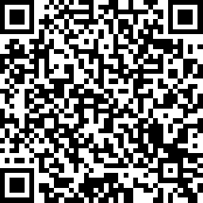
Workgroup
Sign Up
https://www.surveymonkey.com/r/OTF2025

Slide 26

Questions & answers

Slide 27
Closing remarks

