Slide 1



OCTOBER 22, 2024
10:00 AM – 11:30 AM
MVCC: ROOM ACC 116

Slide 2
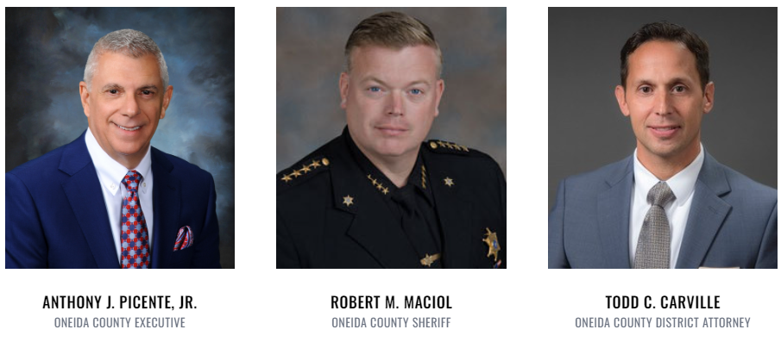

Welcome & Introductions
Co-Chairs

Slide 3

Trends & partner updates

Slide 4







DATA ANALYSIS SUBTEAM
OVERDOSE RESPONSE TEAM
Mohawk Valley Crime Analysis Center
Data Analysis Sub-team
SSG CORY WHITE
(17OCT2024)
MVCAC / NYNGCDTF

Slide 5






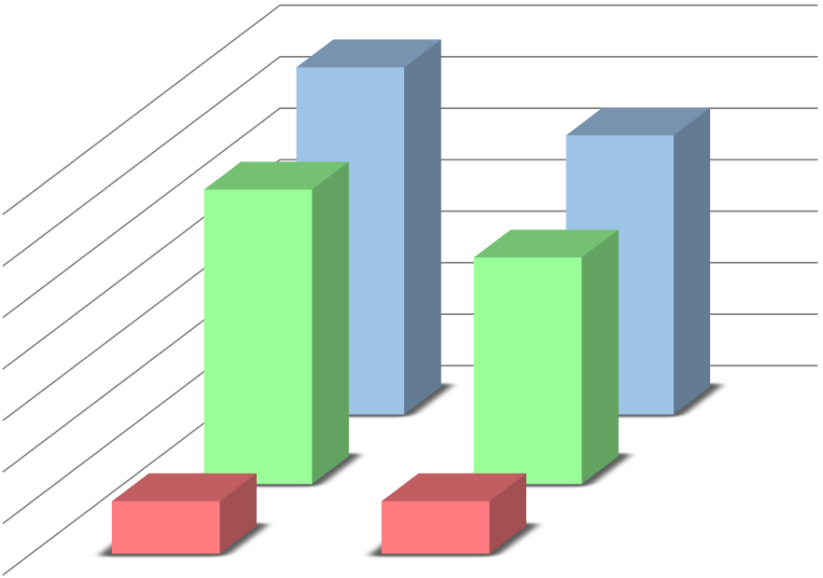






























DATA ANALYSIS SUBTEAM
NALOXONE ADMINISTERED BY BYSTANDER
49
YEAR TO DATE
40%
 |  |  | 337
350 |  | 286
300
250
200
150
100
50 | 51 |  |  | 51
0
20%
271
23%
220
TOTAL
NON-FATALITIES
44
SINGLE
FATALITIES
YTD CY23 YTD CY24
FATALITIES NON-FATALITIES
TOTAL
TOTAL
117
NONE
271
110
MULTIPLE
NALOXONE USED

Slide 6




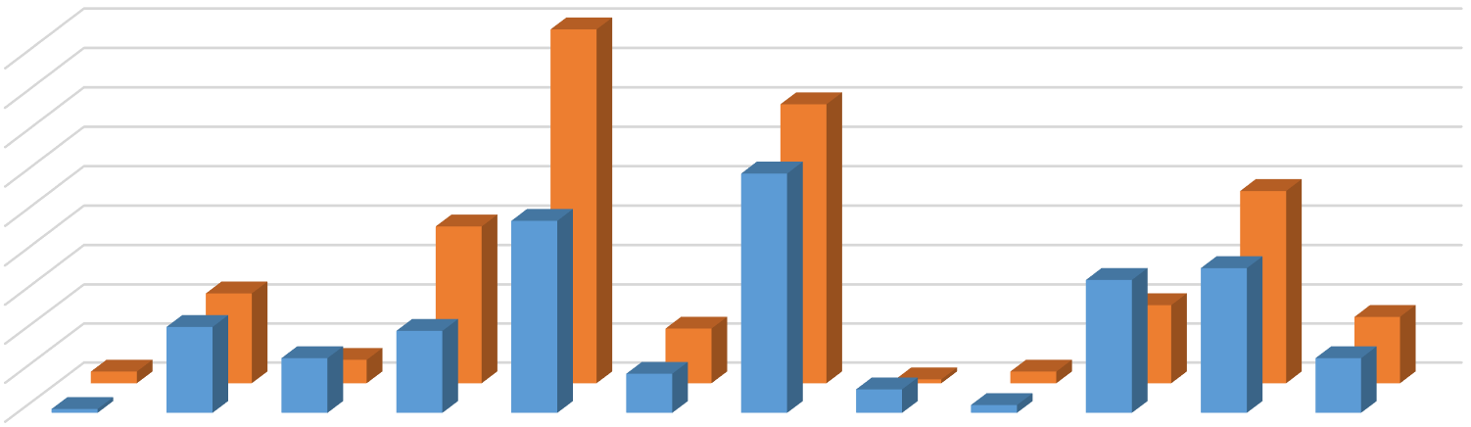







DATA ANALYSIS SUBTEAM
SUSPECTED DRUG USED IN OVERDOSE
- 39 of 49 (80%)
overdoses involved naloxone administration
- 44 of 61 (72%)
overdoses involved naloxone administration
90
- 20 of 37 (54%)
overdoses involved naloxone administrartion
90
80
70
60
50
40
30
20
10
0
- 12 of 21 (57%)
overdoses involved naloxone administration
71
- 9 of 34 (26%)
overdoses involved naloxone administration
49
40
23
61
20
17
49
14
3
6
10
1
3
34
37
1
22
14
21
6
2
14
YTD CY24 YTD CY23

Slide 7






DATA ANALYSIS SUBTEAM
DRUG USED IN FATAL OVERDOSES
17
18
16
14
12
10
8
6
4
2
0
10
- 3 of 17 fatal cases involving Fentanyl contained Xylazine
8
- 2 of 8 fatal cases involving Other drugs containing Bromazolam
4
4
5
1
3
1
1
2

Slide 8



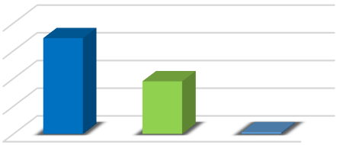
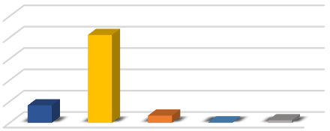
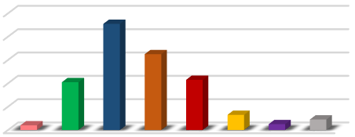




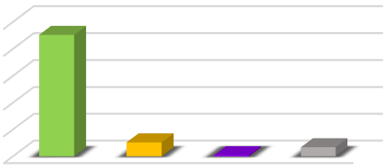
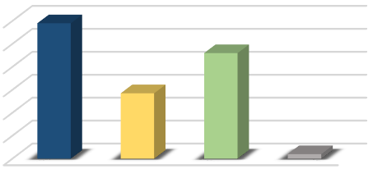
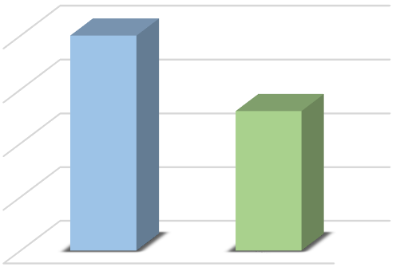


DATA ANALYSIS SUBTEAM
GENDER
RACE
206
VICTIMS BY AGE
100
80
60
40
20
0
200
150
100
50
0
173
250
200
150
100 41
50
0
95
3
17
1
6
TYPE OF OD
226
LOCATION
120
100
80
60
40
20
0
MULTIPLE OD’S
250
200
150
100
50
0
40
30
20
10
0
26
2
17
MALE
FEMALE

Slide 9





DATA ANALYSIS SUBTEAM
CITY/TOWN WHERE OD OCCURRED
Whitestown Whitesboro Westmoreland Warterville
Vienna Verona Vernon
Utica
Sylvan Beach
Rome
Remsen
Paris Oriskany Falls
Oriskany New York Mills New Hartford
Marshall
Marcy
Lee Kirkland Forestport
Floyd Deerfield Clinton
Chadwicks
Bridgewater Boonville Blossvale Barneveld
Ava Augusta Annsville
1
2
3
3
2
3
2
Utica: 56% of
OD’s in Oneida County.
154
1
42
1
1
1
3
3
Rome: 15% of
OD’s in Oneida
County.
21
2
4
3
New Hartford:
8% of OD’s in Oneida County.
2
1
1
1
2
1
2
3
1
1
1
1
2
0
20
40
60
80
100
120
140
160
180

Slide 10

DATA ANALYSIS SUBTEAM
OVERDOSE BY MONTH AND DAY OF THE WEEK
12
10
8
6
4
2
0
January
February
March
April
May
June
July
August
September
October November December
0 0
0 0
0 0
0 0
0 0
0 0
0 0
Monday
4
2
5
3
2
7
9
7
6
0
Tuesday
6
5
2
6
4
5
5
1
5
2
Wednesday
3
2
3
9
4
5
2
2
5
3
Thursday
2
4
6
2
10
3
2
7
4
2
Friday
3 6
0 1
4 2
Monday Tuesday Wednesday
6 3
4 3
2 3
Thursday Friday Saturday Sunday
8
4
4
4
0
4
Saturday
3
9
4
3
3
2
Sunday
2
7
1
5
3
2
As of 10/17/2024, February has the most recorded overdoses with a total of 33.
As of 10/17/2024, Monday has the most recorded overdoses with a total of 45.

Slide 11
Oneida County Opioid Response Awardees
The funds for this RFP were made available through Opioid Settlement Funds (OSF) that the OCDMH received through the NYS OASAS.
5 agencies were awarded projects of various amounts
Projects awarded will help enhance and create new avenues of treatment and prevention for our rural communities, our youth in schools, and our most vulnerable.
The goal for this RFP was to establish projects whose priority areas include harm reduction, treatment investments across the service continuum, priority populations, housing, recovery, prevention, transportation, public awareness, and research.
The RFP was issued in the Fall of 2023.

Slide 12


Oneida county opioid response project #1
Heather campbell
“Oneida County Rural Treatment Expansion Project”

Slide 13

Oneida County Rural Treatment Expansion Project Update
  Developed satellite of the Utica CCBHC to expand services at the Camden Life Center.
  Initiated on-site counseling in June 2024.
  Initiated peer services to provide rural outreach in July 2024.
  The full-time peer position is currently vacant.
  Staff at the Utica CCBHC have been providing outreach services.
Oneida County Rural Treatment Expansion Project Update
October 24, 2024

Slide 14
Data and Trends
  35 unique individuals have been connected to services
  Methamphetamine and alcohol are the most prevalent substances identified
  Peer has provided outreach services to over 30 different rural locations including Lee Center, Boonville, Camden, Blossvale, Lee, Annsville, and Taberg
  Held awareness events in Camden, Remsen, and Holland Patent
Oneida County Rural Treatment Expansion Project Update
October 24, 2024

Slide 15

Oneida county opioid response project #2
Rebeccah campbell
“Enhanced Peer Services to Increase Engagement in Recovery Support Services”

Slide 16
OVERVIEW
Staffing case management at the Rescue Mission of Utica's Drop-In Center.
  Crisis
  Connect with Mental Health and/or Substance Use Disorder services
  Assistance in connecting to basic needs such as food and housing
  Assistance navigating social services or the healthcare systems
  Providing transportation support to assure continuity of care.
Upstate Caring Partners
Community Health and Behavioral Services
Expansion of Peer Recovery Services

Slide 17
Procurement of an agency vehicle to assist in connecting individuals to mental health and substance abuse services and basic needs
Trained Rescue Mission Drop-In Center Staff on Mental Health First Aid
Peer presence at the Salvation Army lunch service each Tuesday
Our agency has been working to being build out the walk-in center at 1427 Genesee St.! The goal is to have this operation functional by Spring of 2025, allowing outreach to occur in a new location
HIGHLIGHTS

Slide 18
Impact, Outcomes, and Gaps
Service 83 Unique individuals since April 2024 at the Rescue Mission Drop-in, ages 18 to 72.
Assisted in housing 15 individuals.
Treatment and other avenues of support would become a secondary concern due to having their basic needs met.
Community based Clinician for targeted sites.
Domestic Violence and Sexual Violence Services and supports.
Naturalization/ Immigration supports.
Lack of Housing and long waitlists for housing related programs.
Employment opportunities for individuals with no college and little job experience.
Dental services needed at targeted sites for homeless and at-risk.
DATA & TRENDS

Slide 19

Oneida county opioid response project #3 natalie zumpano
“School Opioid Response Project”

Slide 20
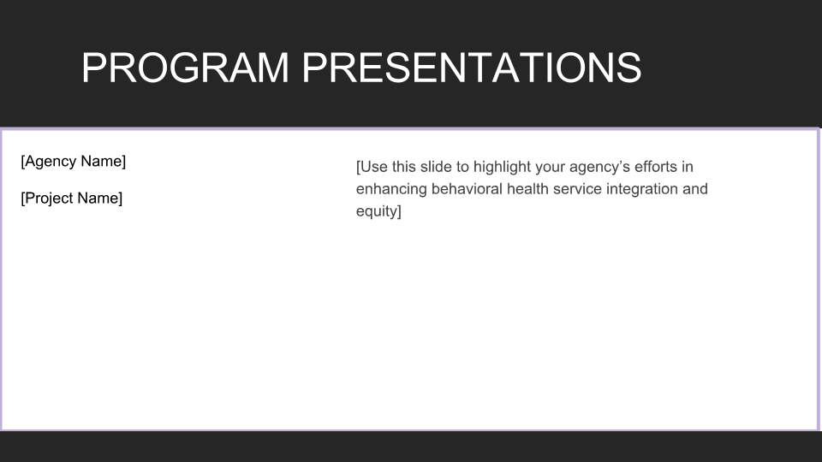
Strategy Meetings
SNOOT
TINAD
SBIRT
Screening,
Brief Intervention & Referral to Treatment
This Is Not
About Drugs
School Naloxone Opioid Overdose Training
PREVENTION THROUGH EDUCATION

Slide 21
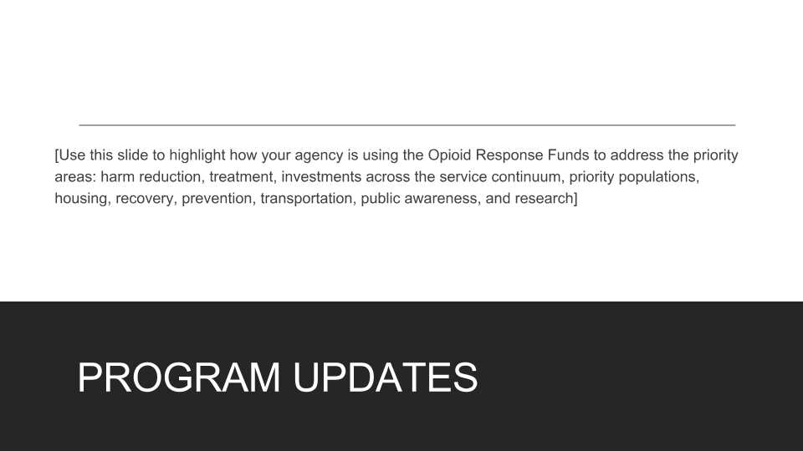
Educators
SNOOT
Strategy Meetings

Slide 22
This Is Not About Drugs
SBIRT
STUDENTS

Slide 23
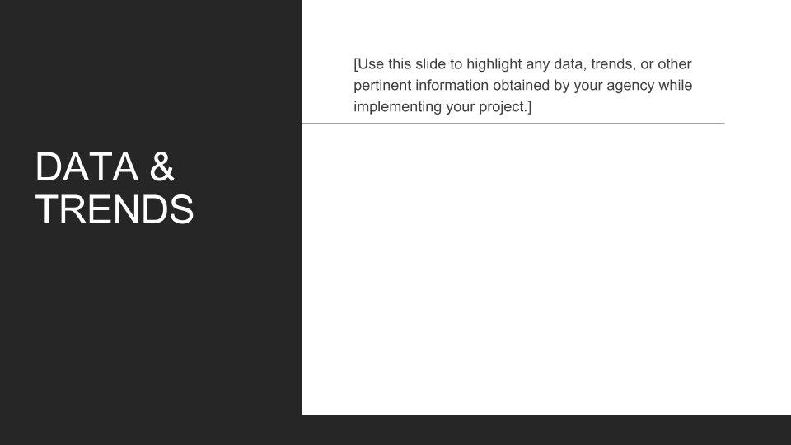
Peer-Based Program Model
Diverse Training Delivery Methods
Holistic Approaches
Community and School Involvement
Addressing Stigma

Slide 24

Oneida county opioid response project #4
Colleen Callaghan-Kirkland
KATIE RODRIGUEZ
“Certified Recovery Peer Advocate Growth in Oneida County”

Slide 25
Personal Testimonial
“How has CFLR’s Peer Training and collaboration impacted my life”?
Josh stated “The trainings equipped me with essential skills and knowledge to effectively support individuals facing their own challenges. Funding removed financial barriers, allowing me to focus solely on my development and the impact I can make. Knowing that an agency believes in my potential and the importance of peer support will motivate me to be the best advocate I can be.”
JJ stated “Peer Alliance and Collaboration helped me stay sober and learn what it takes to be a peer. I am the walking definition of turning a drug addicted person into something”.
Tony stated “It’s given me a new sense of purpose; I love the feeling I get with each new achievement, and I can feel the ‘growth’ and see progress every week. I would not have had the push and support to get my license back.”

Slide 26


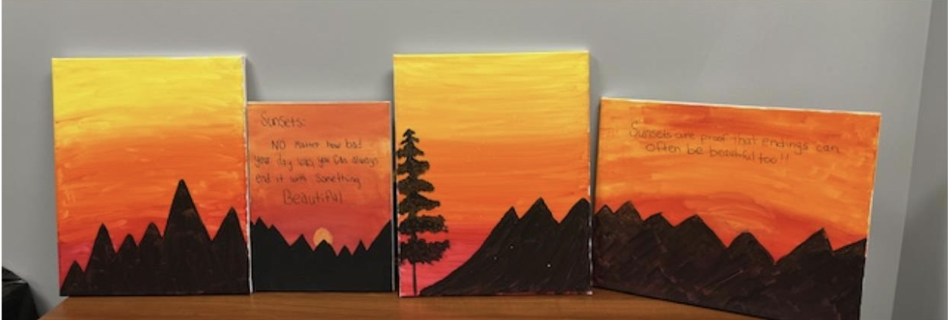
Wellness Topics
Each month our Peer Collaboration incorporates Wellness for ourselves.
Some of the most recent or upcoming topics include Music & Mental Health, Sunset Guided paint, a trip to the Zoo, Book Art, Comets Game, Pinecone Center Pieces and Munson Williams Art Institute.

Slide 27
Peer Alliance Education Group
Week One: Working Agreements
  What a facilitator should expect from you.
  Intro to self.
  Week where individuals who are unsure can sit in.
Week Two: Defining Coaching
  Different between Peers, Counselors and Sponsors
Week Three and Four: SOAR (Science of Addiction & Recovery)
Week Five: Motivational Interviewing
  Sit in week is also offered here.
Week Six: Professionalism
  Elevator Pitches
Week Seven: Mock Interviews and Mock Sessions

Slide 28

Additional Information About Programs
Currently we have 5 individuals from Oneida County who are participating in 50 hours of foundational training with Herkimer County Catholic Charities. They will be able to apply for their CRPA/P after October 29. Since the grant started in June 2024, we’ve had 24 community members engage in our services of becoming a Peer.
Testimonial from a Grant Funder:
  “This partnership has allowed our organizations to amplify the voice to the recovery community, provide educational resources and train along with expand a recovery peer workforce that can adequately support the recovery community”.

Slide 29

Oneida county opioid response project #5 camila saez
“Incentivize EndODNY in Oneida County”

Slide 30
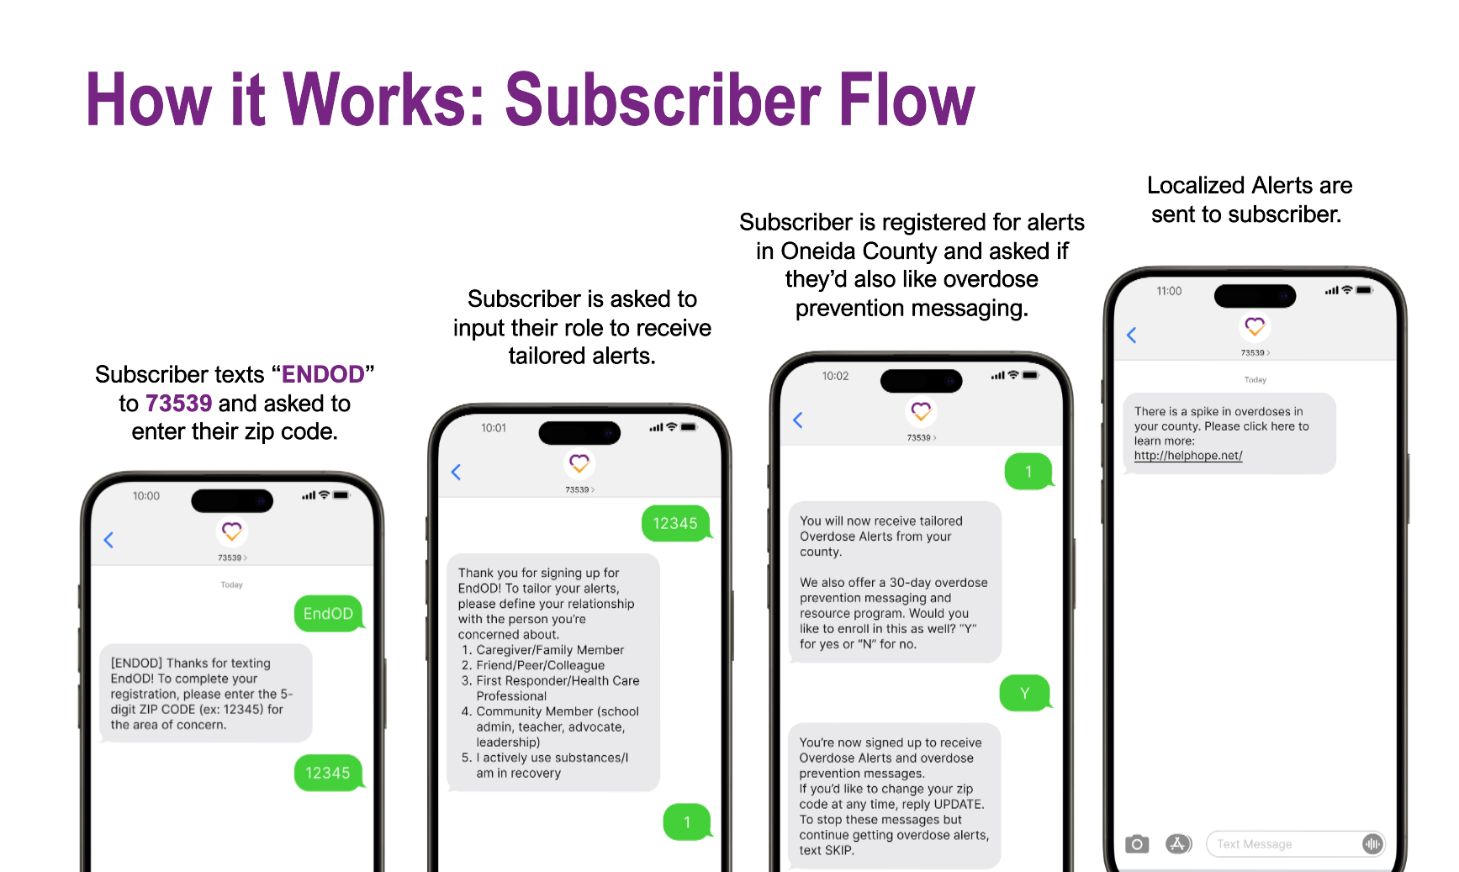

Partnership to End Addiction
EndOD with Oneida County
In efforts to help families with loved ones struggling with addiction, the Partnership created EndOD. EndOD is a SMS program that provides communities with real-time notifications and relevant information about overdoses and how to prevent them. The program has two components:
Real-Time Notifications
Enrollees receive:
Notifications about overdose spikes in their area
Alerts can also be leveraged by counties to send blasts about local events and resources.
Automated Educational & Resources Messaging
Enrollees receive:
Scheduled messages about overdose prevention, useful skills, and finding support
Other content that jurisdictions would like to share with their residents.
Participants can enroll in one or both and indicate the location from where they'd like to receive messaging from.
Notes:
[Use this slide to highlight your agency’s efforts in enhancing behavioral health service integration and equity]

Slide 31
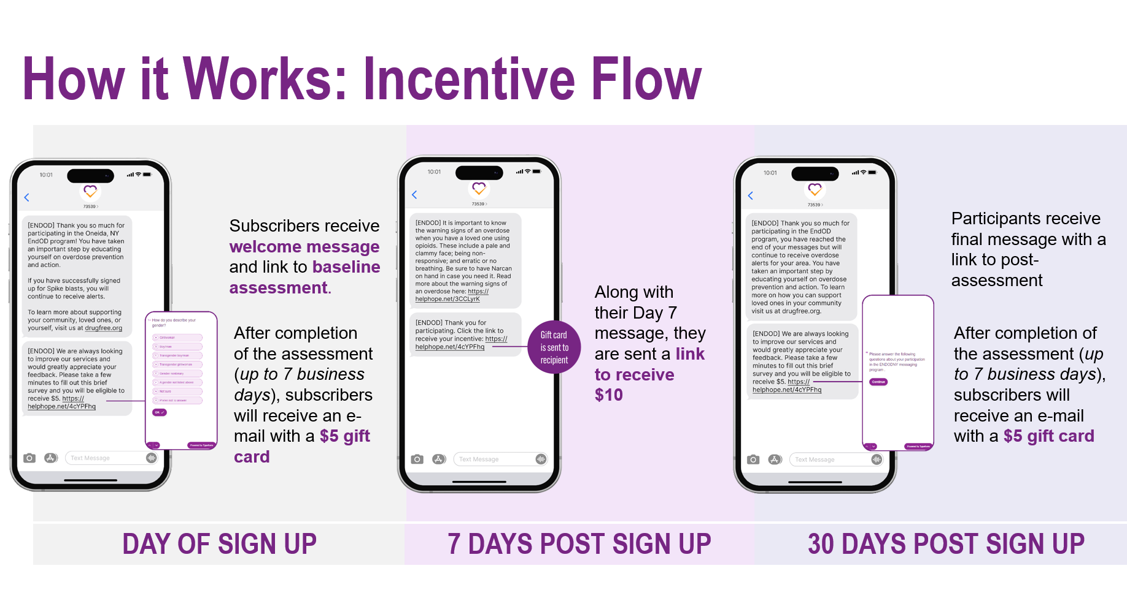
Program Updates
Below are activities we implemented to be fully ready for launch:
Built the EndOD Oneida program
Added EndOD Oneida program to our platform
Designed assets to promote EndOD Oneida program
Attended events to present EndOD Oneida program
Next Steps:
Attend Upcoming Events
Track Signups
Distribute Incentives
Maintenance of Program
Evaluation Data
Notes:
[Use this slide to highlight how your agency is using the Opioid Response Funds to address the priority areas: harm reduction, treatment, investments across the service continuum, priority populations, housing, recovery, prevention, transportation, public awareness, and research]

Slide 32
Successes
Program Implementation
  Fully implemented program for launch with incentives for Oneida County on August 23rd, 2024.
Presentations of EndOD Oneida Program
  Partnership’s presentation on the EndOD Oneida program was well received by attendees at both virtual events.
Challenges
Lack of community engagement activities
  Despite our best efforts to find and participate in community engagement activities, there has been a noticeable lack of consistent opportunities. This shortage limits our ability to maintain a strong presence and build deeper connections within the community.
We need to work on increasing engagement
  We will continue to actively seek out new community engagement opportunities by staying informed about upcoming events. Additionally, we plan to explore innovative ways to create our own engagement initiatives
Data & Trends
Notes:
[Use this slide to highlight any data, trends, or other pertinent information obtained by your agency while implementing your project.]

Slide 33
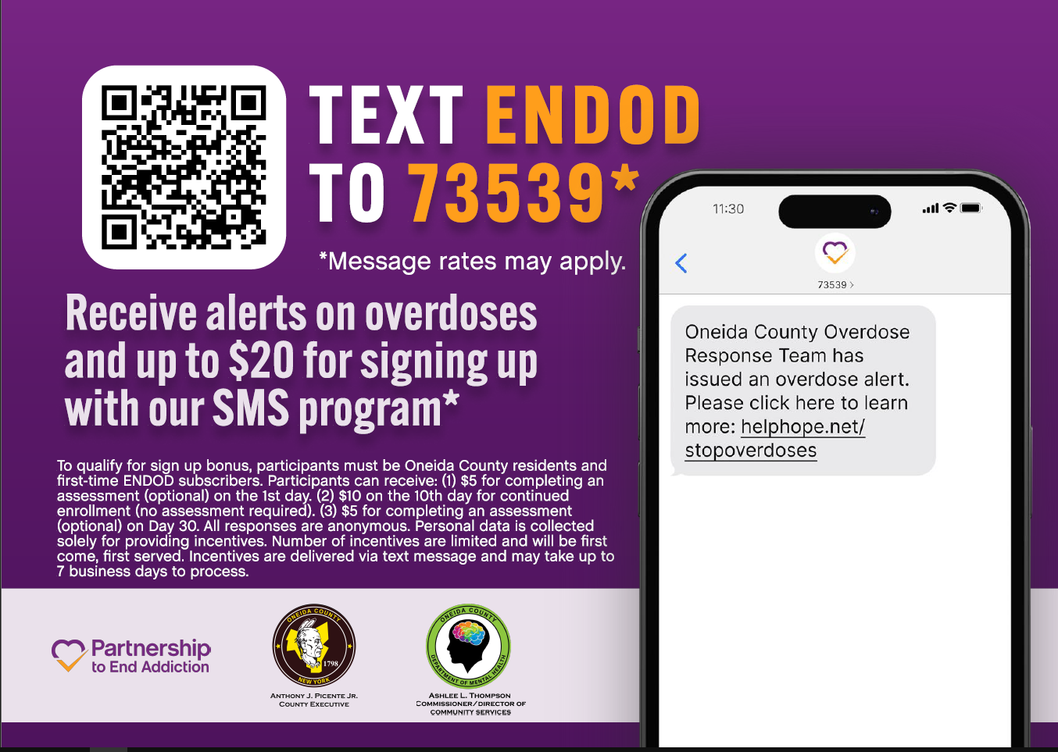

Slide 34

Questions & answers

Slide 35
Closing remarks

