Slide 1

ONEIDA COUNTY
OPIOID TASK FORCE
MEETING
June 30, 2021 - 10:00 AM - 11:30 AM

Slide 2
Housekeeping Items
  Enter your NAME and ORGANIZATION in the chat box.
  Please keep your microphone muted, unless you are speaking.
  The contents of this presentation will be sent out via email following today's meeting.

Slide 3
Agenda
June 30, 2021 - 10:00 AM - 11:30 AM
  Welcome & Introductions
  Partner Discussion: Reflections Post-COVID
  Spike Alert by Text Pilot Program
  Other Updates
      2020 & 2021 Data Highlights & Post Overdose Outreach Expansion
      Team Initiatives & Proposed Projects Overview
  Next Meeting
Notes:
The majority of today's meeting will be hearing from you all.

Slide 4

Welcome & Introductions
County Executive Anthony J. Picente, Jr., Co-Chair
District Attorney Scott D. McNamara, Co-Chair
Sheriff Robert M. Maciol, Co-Chair
Ashlee L. Thompson, Oneida County Dept. of Mental Health
Daniel W. Gilmore, Oneida County Health Dept.
Notes:
Just to give a brief overview of the structure that we implemented at the end of last year.

Slide 5
Bureau of Justice Assistance (BJA) Guest Intro & Update
Kristin Stainbrook, PhD., Sr. Research Associate, BJA/CDC 'Partnerships to Support Data Driven Responses to Emerging Drug Threats' Grant Manager
  Grant Extension - Through December 2022
  Oneida County Tentative Implementation Plan:
      Naloxone Expansion
      Fentanyl Test Strip Pilot Project
      Overdose Fatality Review
      Enhanced Post-Overdose Outreach & Rapid Response Teams

Slide 6
Partner Discussion
Reflections on the state of opioids & other emerging drug threats post-COVID.
  Perceptions of how COVID-19 impacted your work?
  Identified patterns or trends in drug use and/or recovery?
  Any particular lessons learned and/or successes? (i.e. what adaptations did you make that worked well?)
  Recommendations for enhancing Task Force initiatives and collaborative efforts moving forward?

Slide 7

Sign Up Now:
Text the word "SPIKE" to 1-855-963-5669
Spike Alert by Text
Elizabeth Mustacchio, Associate Director, Helpline Operations
Kevin Collins, Director, Family and Community Support Services
WHAT: ODMAP data is analyzed to produce alerts, which make participating law enforcement and public health agencies aware of overdose spikes. The Partnership will be utilizing its existing Help and Hope by Text program (https://drugfree.org/get-help-hope-by-text/) to deliver ODMAP spike alert notifications to members of the public. People who subscribe can also opt to receive text messages that will help them help their loved one. The Partnership has received support from the Office of National Drug Control Policy, through HIDTA, to create this Spike Alert by Text pilot program.
WHERE:
      Oneida County, NY
      Jefferson County, NY
      Broome County, NY
      State of Maine
      Nashville / Davidson County Metro Government, TN
WHO: In addition to parents and caregivers concerned about loved ones, this tool can also be used by first responders, treatment providers, recovery support and family serving organizations, as well as other groups.
Notes:
Just to give a brief overview of the structure that we implemented at the end of last year.

Slide 8
ONEIDA COUNTY OPIOID TASK FORCE
COUNTY EXECUTIVE ANTHONY J. PICENTE, JR., CO-CHAIR
DISTRICT ATTORNEY SCOTT D. MCNAMARA, CO-CHAIR
SHERIFF ROBERT M. MACIOL, CO-CHAIR
TASK FORCE STEERING COMMITTEE
ALL TASK FORCE MEMBERS
PREVENTION TEAM
OVERDOSE RESPONSE
TEAM
RECOVERY
TEAM
TREATMENT ENHANCEMENT
TEAM

Slide 9

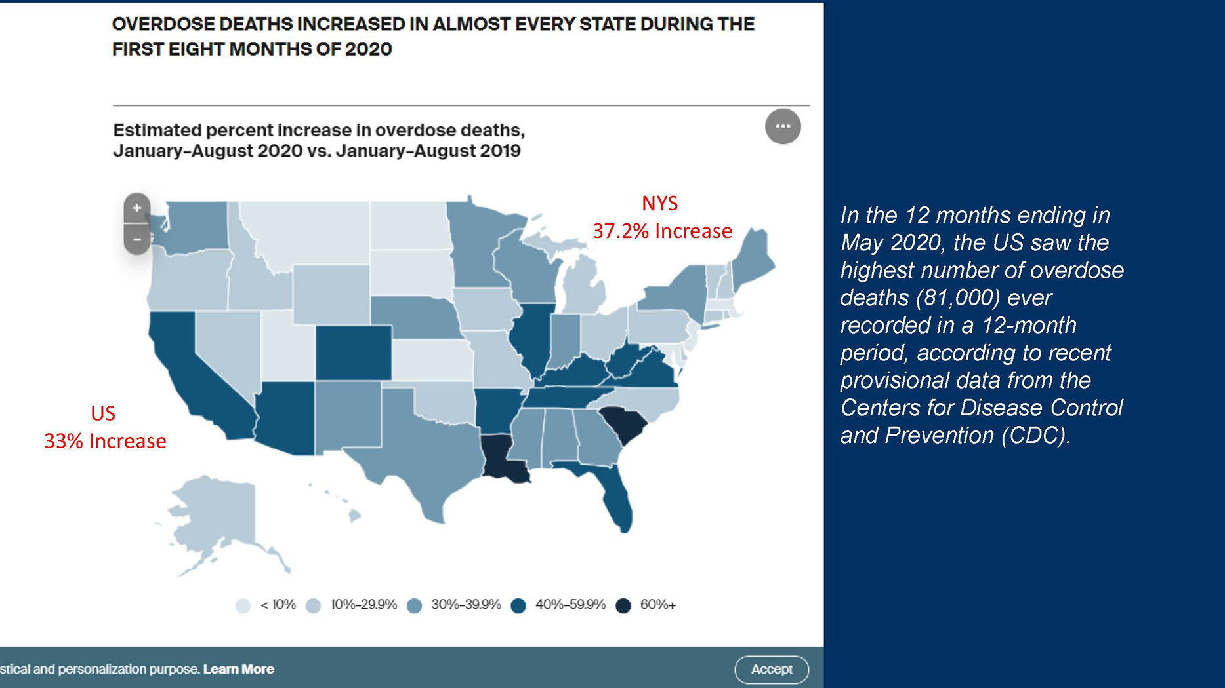
2020 & 2021 Data Highlights & Drug Trends

Slide 10
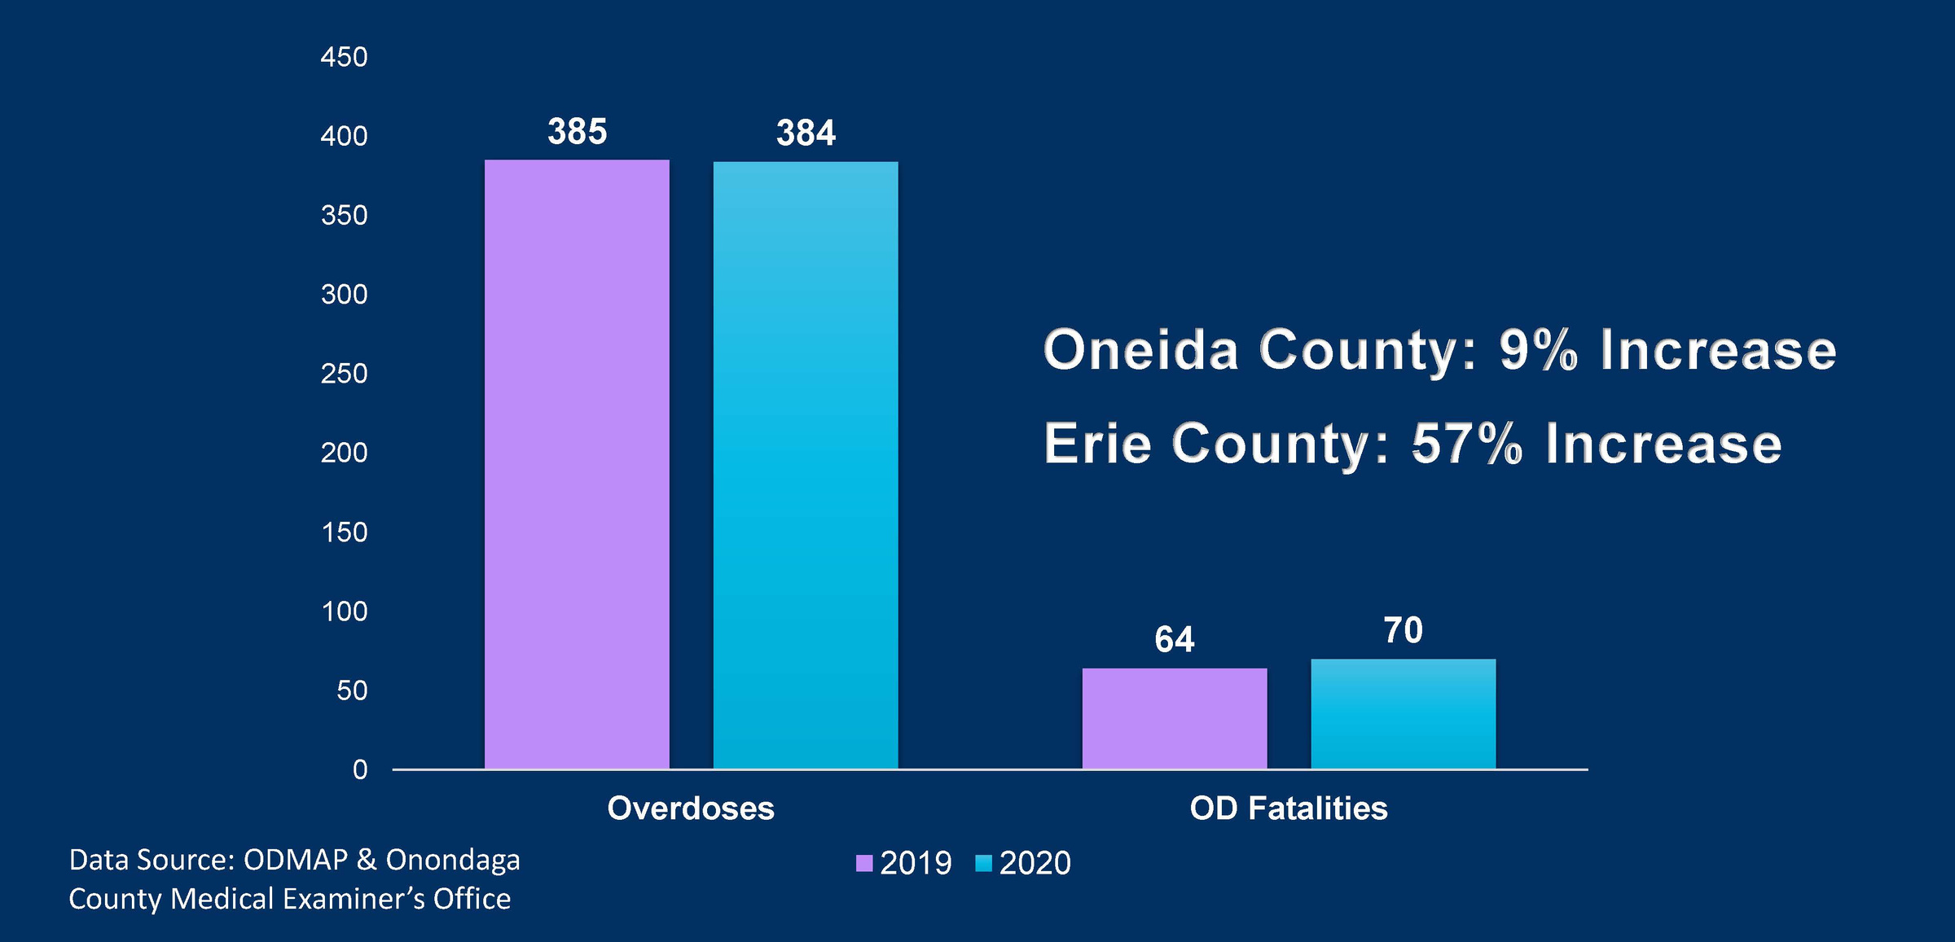
2020 Overdoses & COVID Impact
Oneida County: 9% Increase
Erie County: 57% Increase

Slide 11
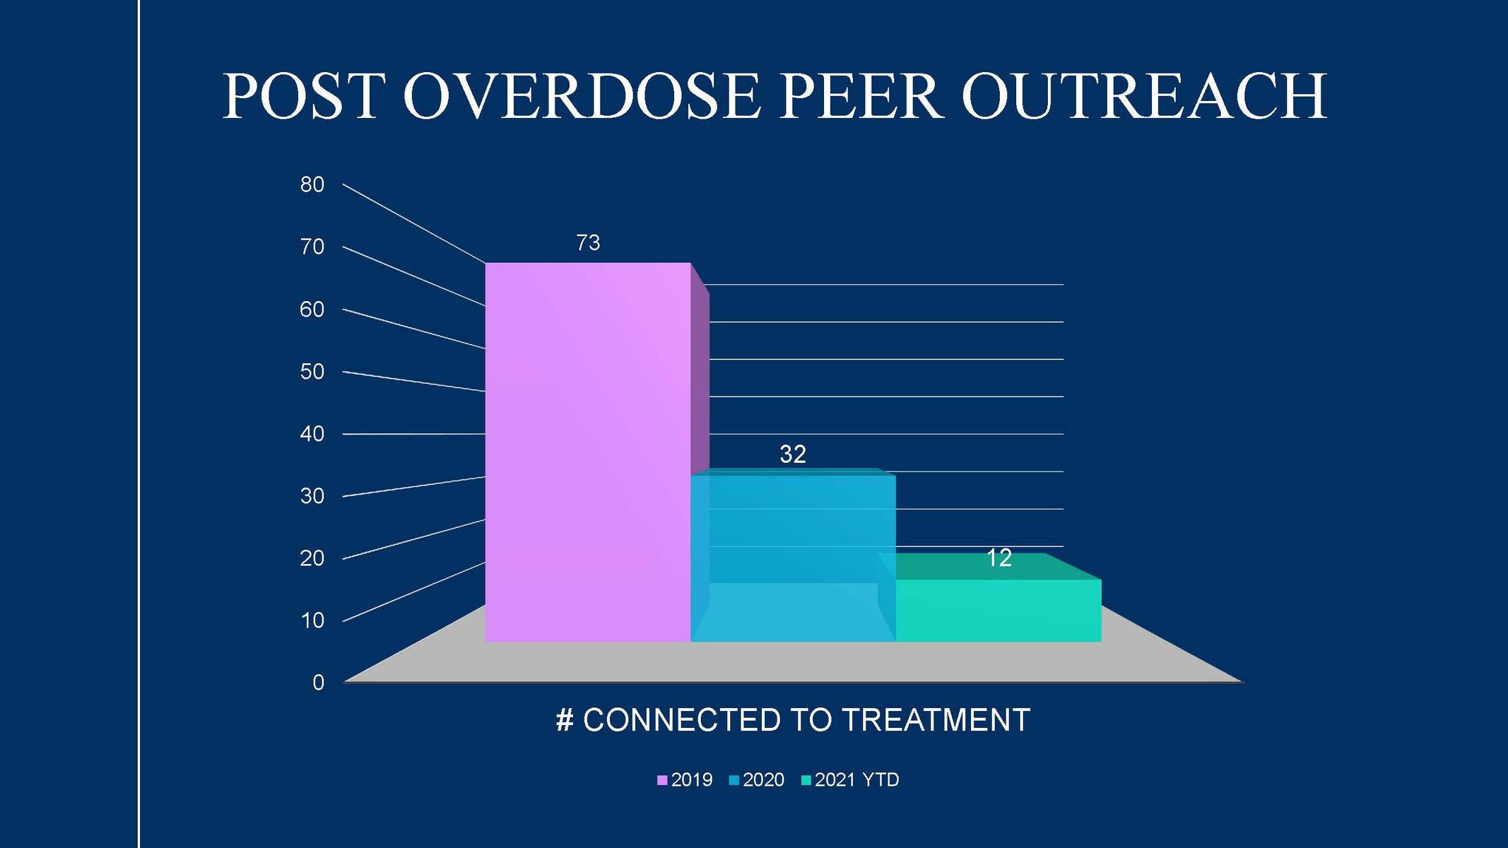
Post Overdose Peer Outreach Data

Slide 12
2021 Overdoses YTD
Oneida County Overdose & Drug Trend Dashboard

Slide 13
Toxicology Report Summary
Detections from 21 Probable and Confirmed Drug-related Fatalities (additional reports tending)
Novel Psychoactive Substance (NPS) | 7
Benzodiazepine | 4
Etizolam | 2
Flubromazolam | 2
Cathinone ("Bath Salts") | 2
Eutylone | 1
Alpha-pyrrolidinoisohexanophenone | 1
Opioid | 1
Methyl AP-237 | 1
*This is a summary of substances detected and not a report of official cause of deaths

Slide 14
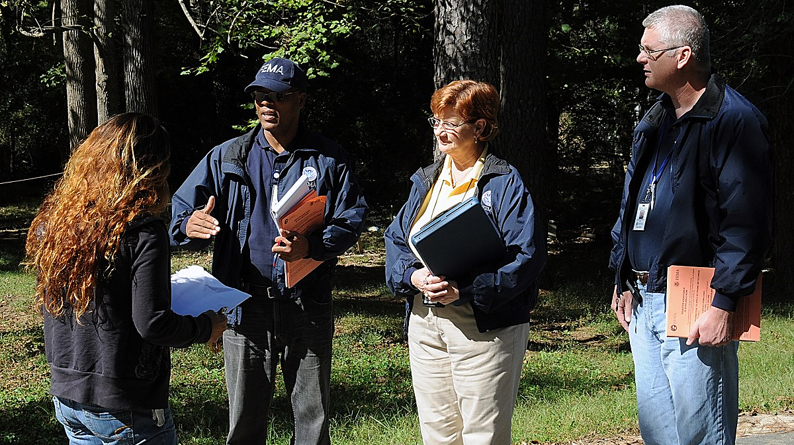
enhanced post overdose outreach & spike response plan
Rescue Mission
COMMUNITY POST SPIKE RAPID RESPONSE OUTREACH
Spike/Cluster Areas
INDIVIDUAL POST OVERDOSE OUTREACH
CRC
Helio Health
ACR HEALTH
CENTRAL POINT OF INTAKE & COORD.
Assessment & Linkage to Appropriate Services
Harm Reduction Community Outreach
(Overdose Kits, Narcan Distribution, Fentanyl Test Strips, Treatment & Recovery Info)
Known High Risk Neighborhoods
Beacon Center
Inpatient Treatment
Community & Neighborhood Events
Syringe Exchange Services
Housing, Food, Shelter

Slide 15
Current Projects Overview
  OTF Website
  Narcan Cabinets
  Fentanyl Test Strips
  Peer Alliance Program (Expanding peer workforce)
  NY MATTERS Program Expansion (Regional Hospitals & Clinics, and Primary Care Providers)

Slide 16

Updated Federal Buprenorphine Waiver Certification Guidelines
  Updated federal guidelines now exempt physicians, PAs and NPs from federal certification requirements related to training, counseling and other ancillary services that are part of the process for obtaining a waiver to treat up to 30 patients with buprenorphine.
  Practitioners utilizing the exemption are limited to treating no more than 30 patients at any one time. Practitioners who do not wish to practice under the exemption and its attendant 30 patient limit may seek a waiver per established protocols.

Slide 17
Thank you!
  Next Meeting:
      October 2021 (Date TBA)
  Quarterly Task Force Meetings, Steering Committee Meetings & Workgroup Meetings to be scheduled.

